Slide 1

The European Commission’s science
and knowledge service
Joint Research Centre
Martin Mühleck
17 July 2017

Slide 2
    The need for evidence to inform policy
Notes:
Today Society is facing many challenges, from energy to migration, and food to environment….these are complex challenges in a changing world
Today more than ever we need sound evidence to support policy, especially in the so called "post fact world"
As a strategic partner at the core of the Commission the JRC is co-designing its work programme with policy DGs and or member states.
Our new vision makes clear that we are moving beyond knowledge production to include management and sense-making.
We now have dedicated KM teams.
We are in the fortunate position of being a research institute inside the executive arm of the EU, able to participate in policymaking discussions. We have +2000 scientists and we cover many scientific disciplines + support almost all EU policies.
This gives us the role to connect disciplines and policies and talk directly to policymakers.

Slide 3
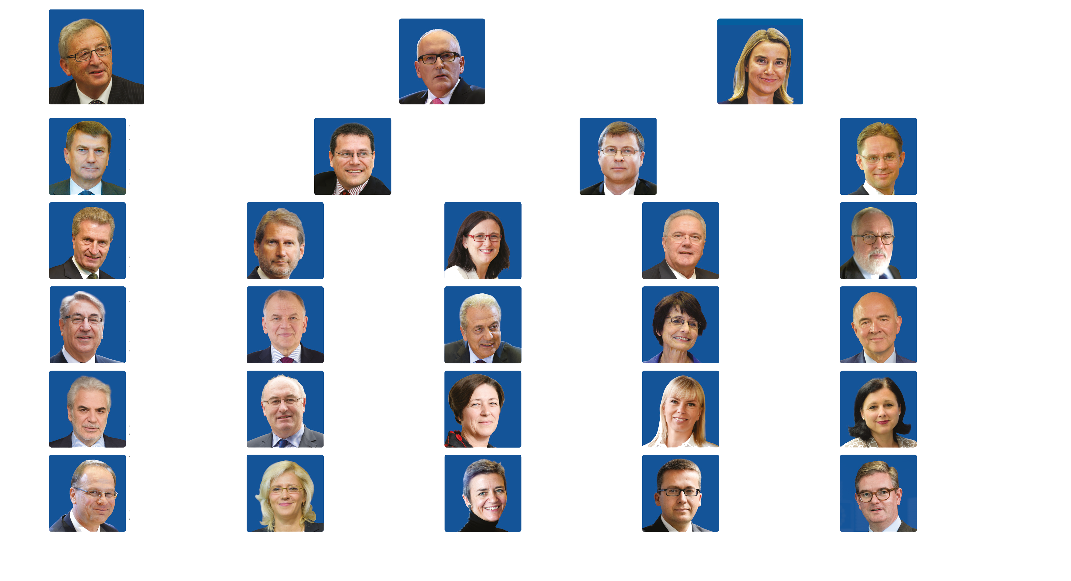
    The JRC within the Commission
JEAN-CLAUDE JUNCKER
PRESIDENT
FRANS TIMMERMANS
FIRST VICE-PRESIDENT
Better Regulation, Interinstitutional Relations, the Rule of Law
and the Charter of Fundamental Rights
FEDERICA MOGHERINI
VICE-PRESIDENT
HIGH REPRESENTATIVE
of the Union for Foreign Affairs
and Security Policy
ANDRUS ANSIP
FIRST VICE-PRESIDENT
Digital Single Market
MAROŠ
ŠEFČOVIČ
FIRST VICE-PRESIDENT
Energy Union
VALDIS
DOMBROVSKIS
VICE-PRESIDENT
Euro and Social Dialogue Financial Stability,
Financial Services and Capital Markets Union
JYRKI
KATAINEN
VICE-PRESIDENT
Jobs, Growth, Investment
and Competitiveness
GÜNTHER
OETTINGER
Budget &
Human Resources
JOHANNES
HAHN
European Neighbourhood
Policy and Enlargement Negotiations
CECILIA
MALMSTRÖM
Trade
NEVEN
MIMICA
International Cooperation
and Development
MIGUEL ARIAS
CAÑETE
Climate Action and Energy
KARMENU
VELLA
Environment, Maritime
Affairs and Fisheries
VYTENIS
ANDRIUKAITIS
Health and Food Safety
DIMITRIS
AVRAMOPOULOS
Migration, Home Affairs
and Citizenship
MARIANNE
THYSSEN
Employment, Social Affairs,
Skills and Labour Mobility
PIERRE
MOSCOVICI
Economic and Financial
Affairs, Taxation and Customs
CHRISTOS
STYLIANIDES
Humanitarian Aid
and Crisis Management
PHIL
HOGAN
Agriculture
and Rural Development
VIOLETA
BULC
Transport
ELŻBIETA BIEŃKOWSKA
Internal Market, Industry,
Entrepreneurship and SMEs
VĚRA
JOUROVÁ
Justice, Consumers
and Gender Equality
TIBOR
NAVRACSICS
Education, Culture, Youth
and Sport
CORINA
CREȚU
Regional Policy
MARGRETHE
VESTAGER
Competition
CARLOS
MOEDAS
Research, Science
and Innovation
JULIAN
KING
Security Union
  European Commission 2014 – 2019, #TeamJunckerEU
Notes:
The JRC is a Directorate-General of the European Commission under the responsibility of Tibor Navracsics, Commissioner for Education, Culture, Youth & Sport. Its Board of Governors assists and advises the Director-General on matters relating to the role and the scientific, technical and financial management of the JRC.
Comprised of strategy and coordination, knowledge production, knowledge management and support directorates, the JRC is spread across six sites in five different countries within the EU.

Slide 4
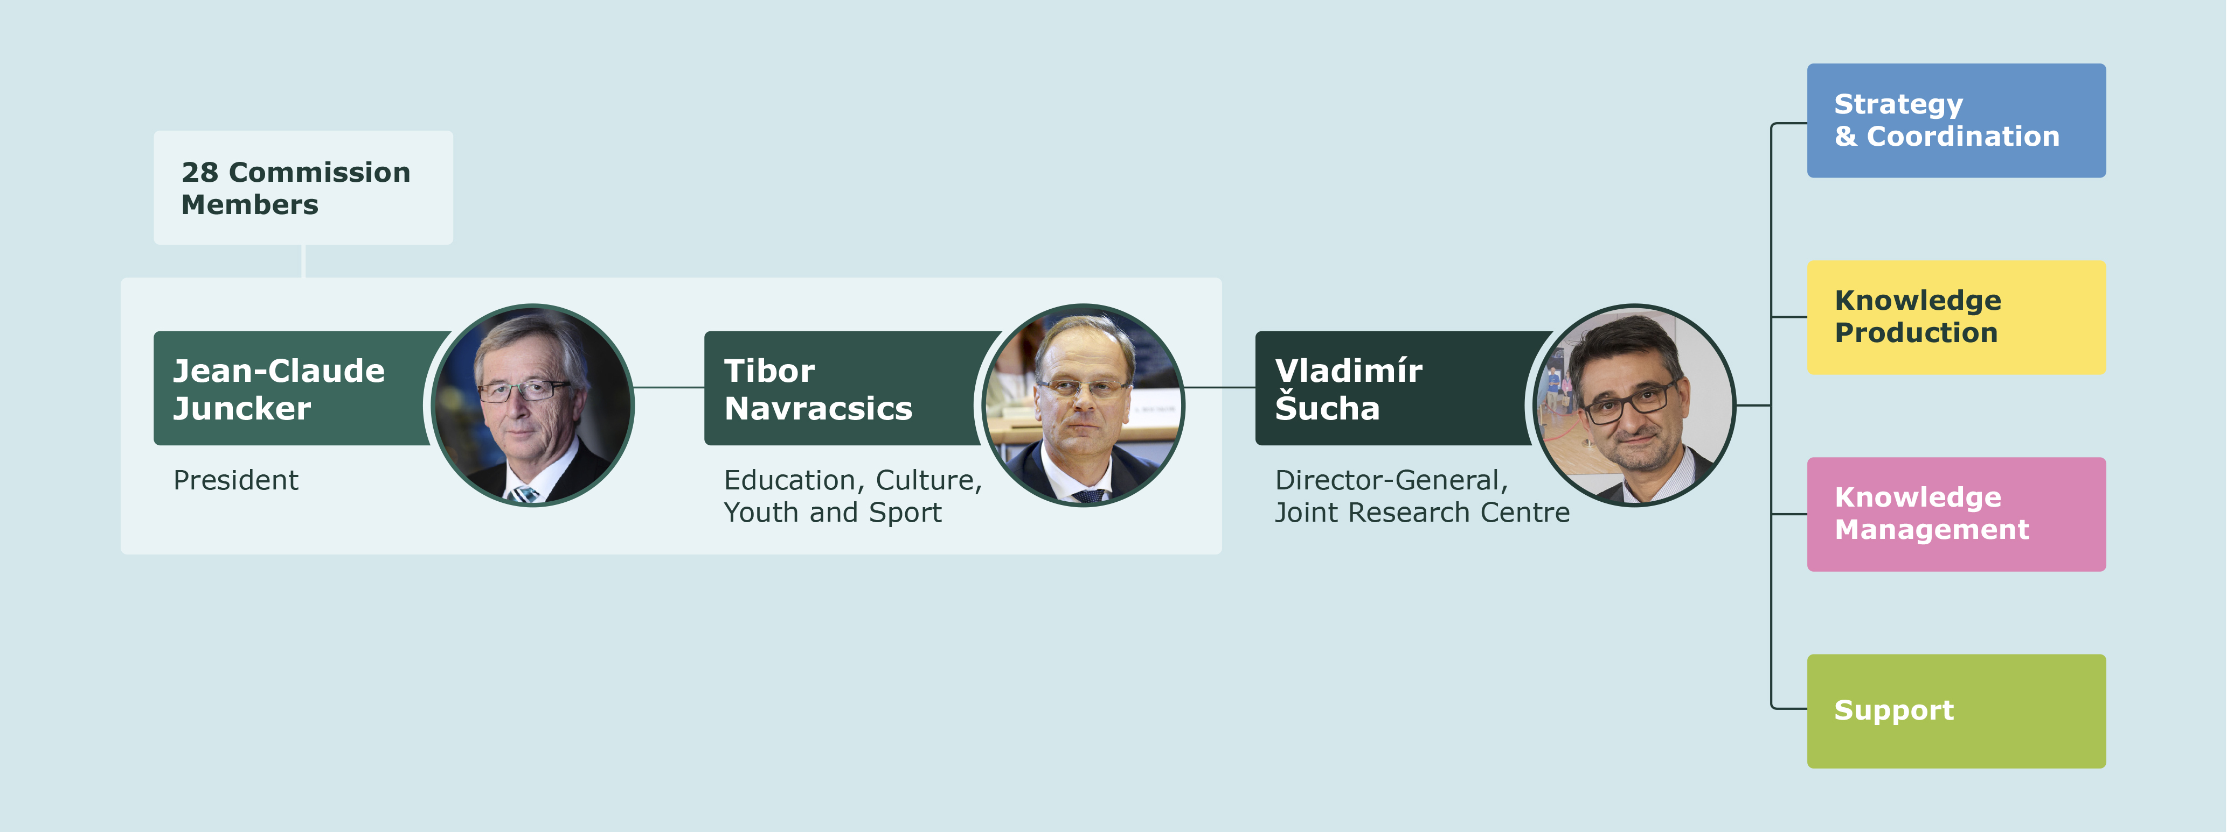
    The JRC within the Commission
Notes:
DG JRC within the Commission

Slide 5
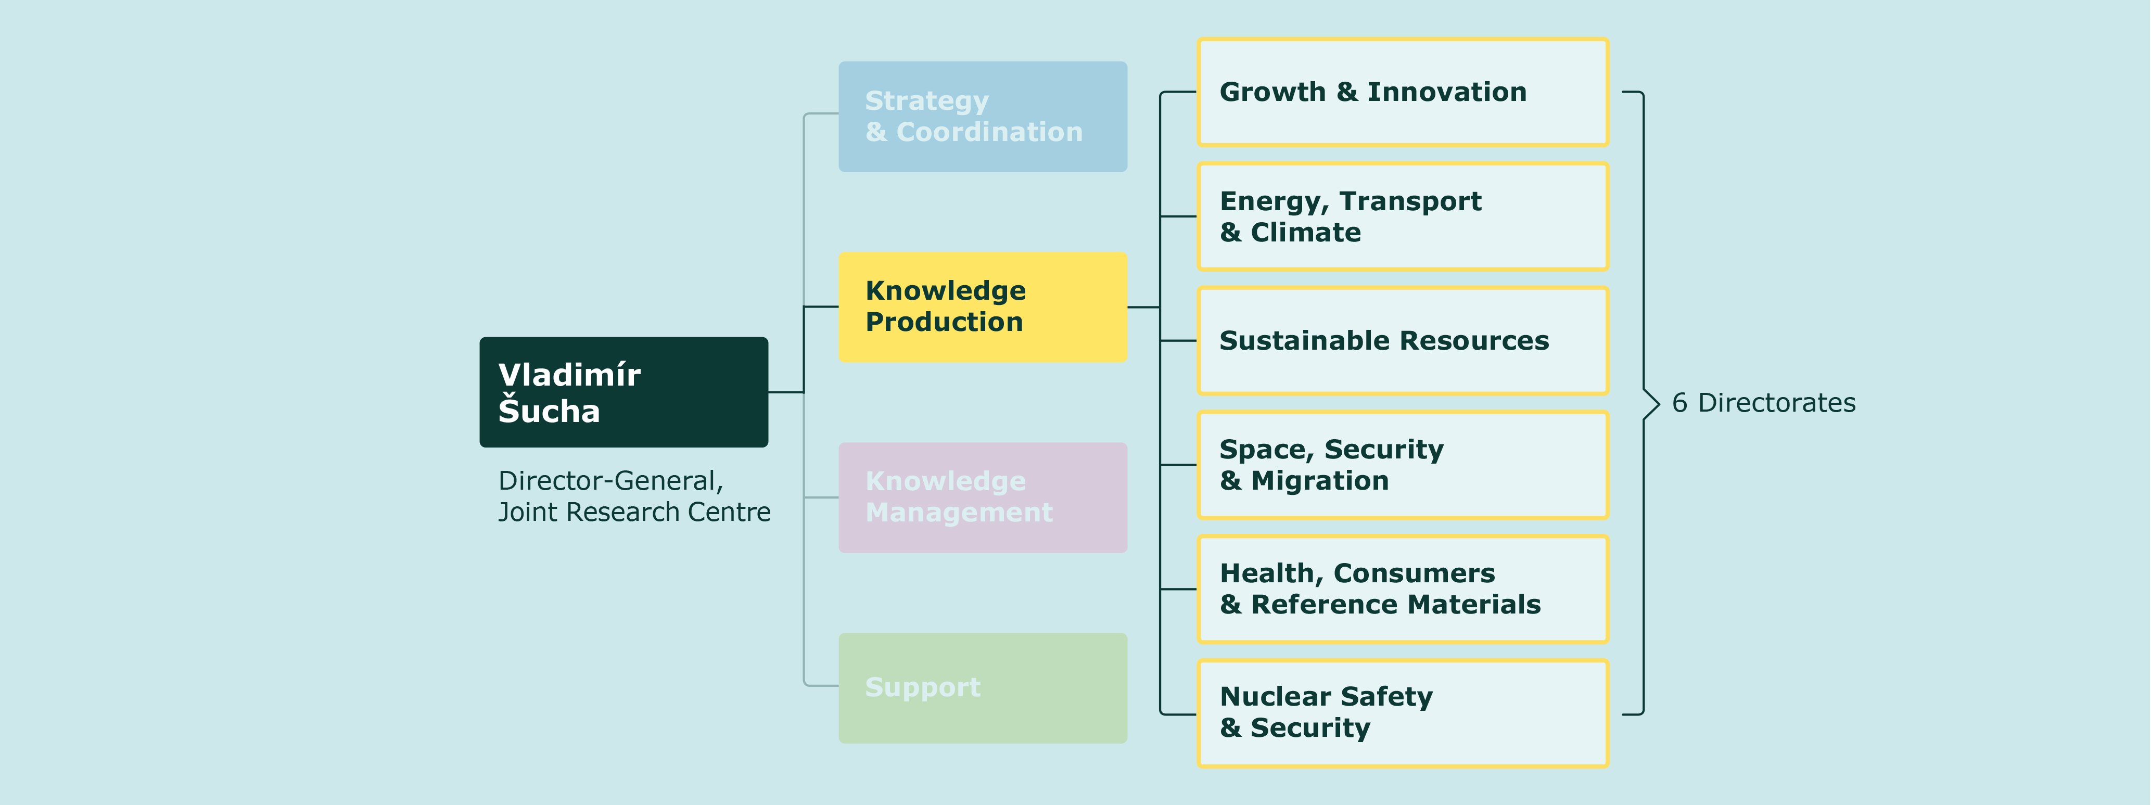
    The JRC within the Commission
Notes:
The new structure of the JRC

Slide 6
    JRC's Mission
"
As the science and knowledge service
of the Commission our mission is to support
EU policies with independent evidence
throughout the whole policy cycle
"
Notes:
Fully policy-relevant and world class knowledge production
Priorities driven knowledge and competence management
One JRC – anticipating emerging issues,
understanding complexities and bridging silos
Addressing challenges of research
(information deluge, multidisciplinarity,
integrity, reproducibility)
Boundary organisation
Independent of private, commercial or national interests
Policy neutral: has no policy agenda of its own
Work for more than 20 EC policy departments

Slide 7
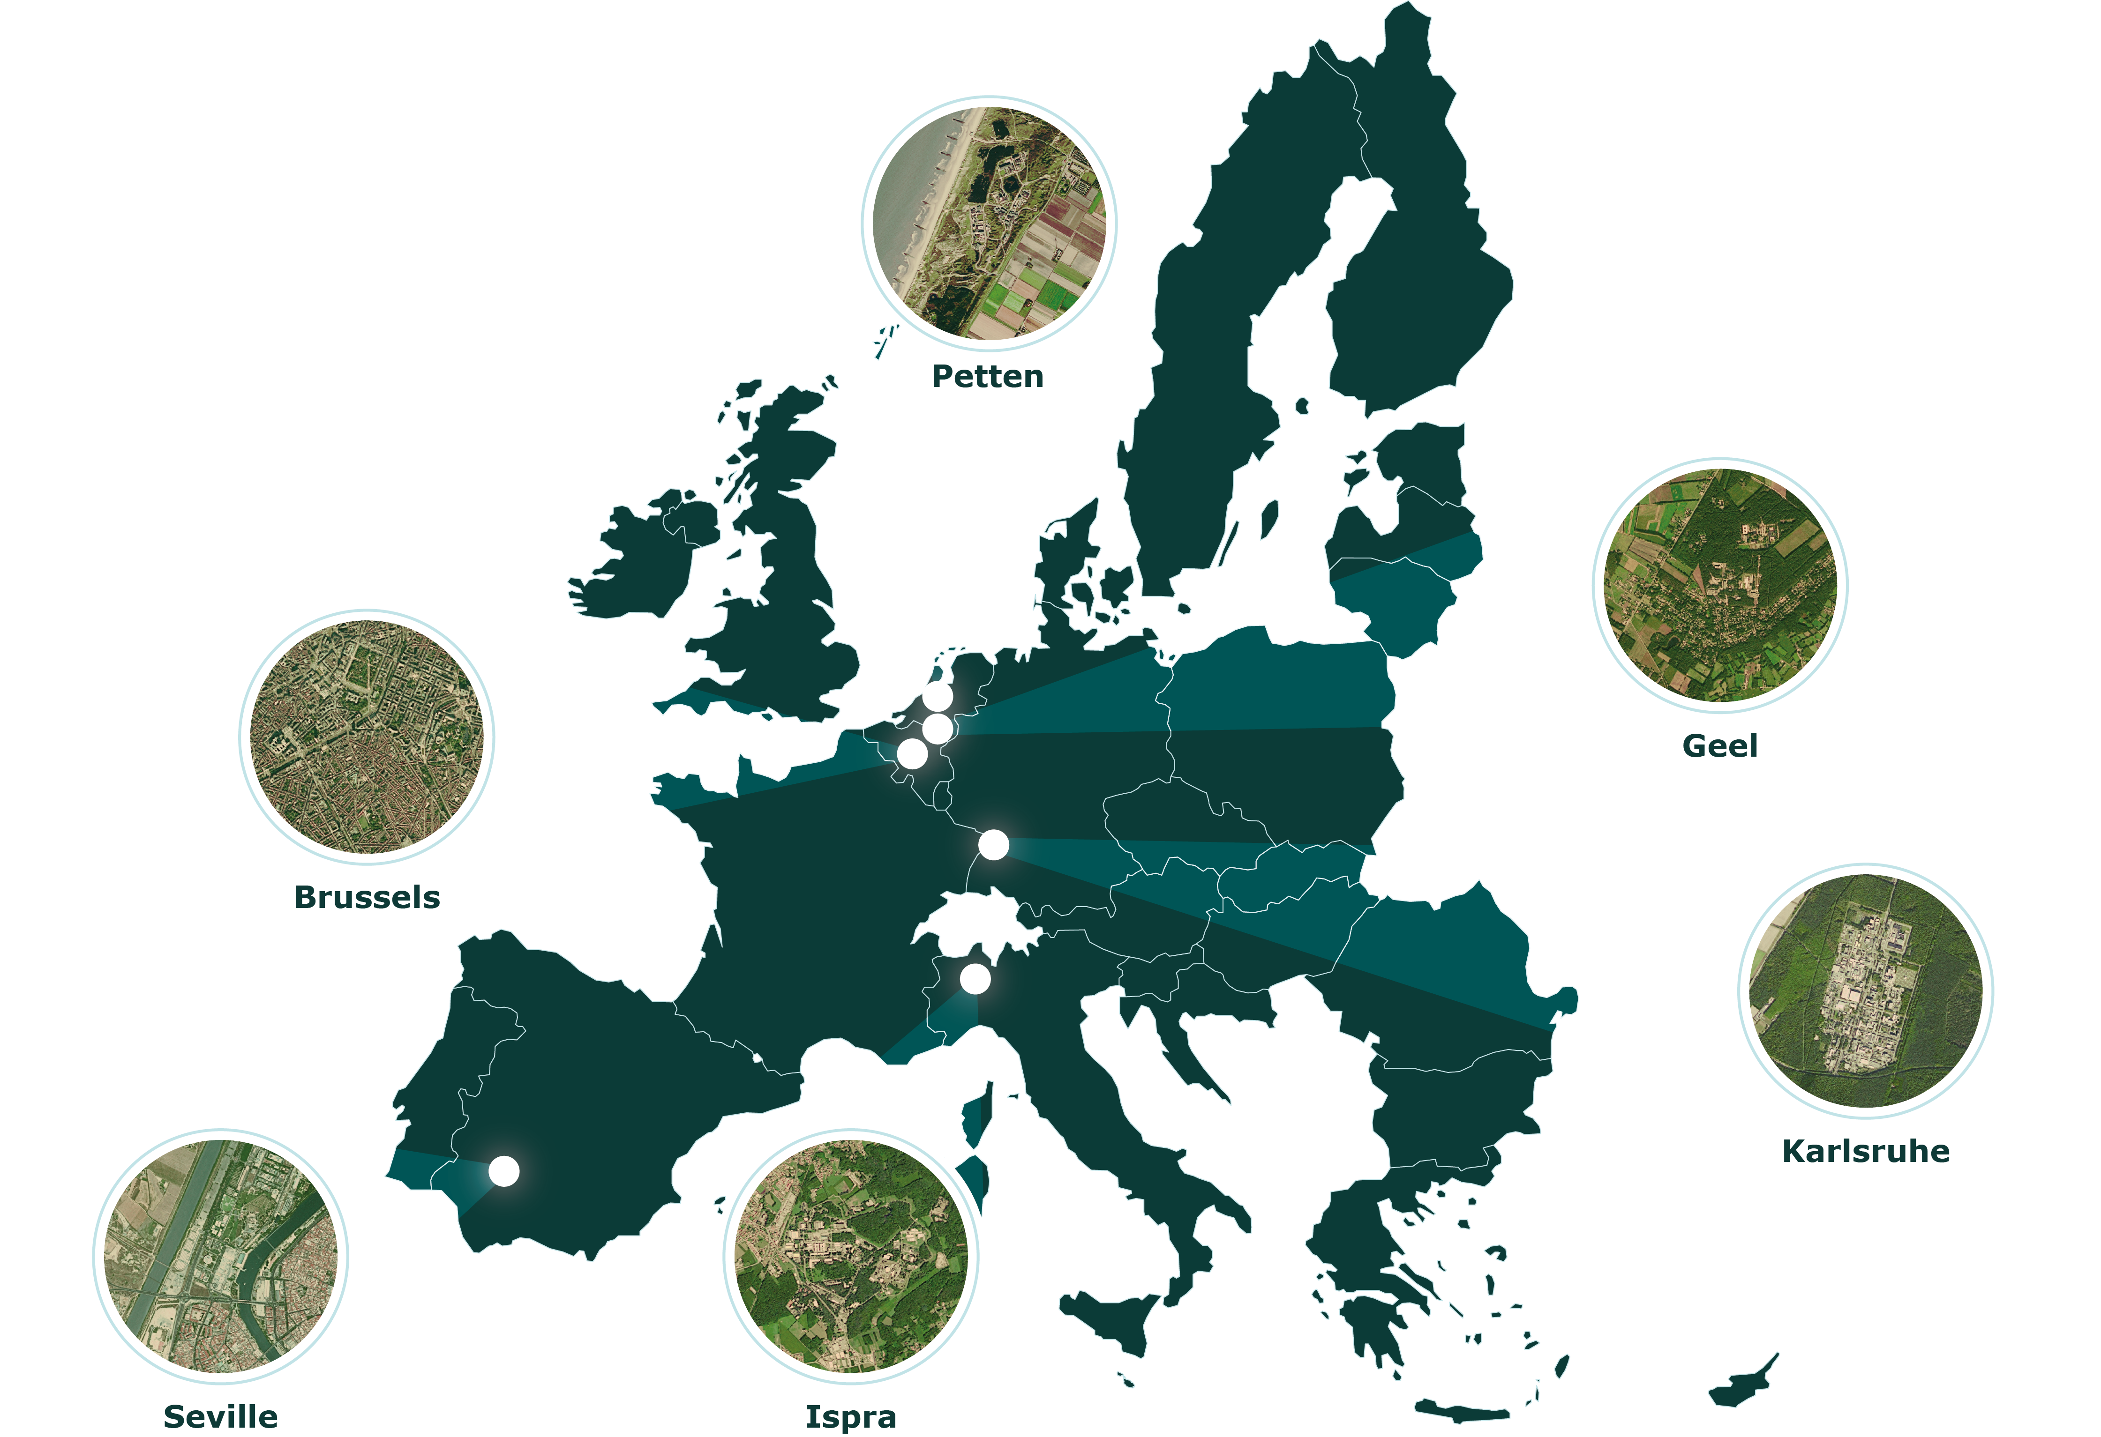
    JRC sites
Headquarters in Brussels
and research facilities located
in 5 Member States:
Belgium (Geel)
Germany (Karlsruhe)
Italy (Ispra)
The Netherlands (Petten)
Spain (Seville)

Slide 8
    JRC Role: facts & figures
€ 386 million Budget annually,
plus € 62 million earned income
6 locations in 5 Member States: Italy, Belgium, Germany, The Netherlands, Spain
Independent of private, commercial or national interests
Policy neutral:
has no policy agenda of its own
42 lаrge scale research facilities, more than 110 online databases
30% of activities in policy preparation, 70% in implementation
JRC
83% of core research staff
with PhD's
125 instances of support
to the EU policy-maker annually
More than 100 economic,
bio-physical and nuclear models
Over 1,400
scientific publications per year
Notes:
Geographical locations of sites.
The JRC draws on over 50 years of scientific experience and continually builds its expertise. Located across five different countries, the JRC hosts specialist laboratories and unique research facilities and is home to thousands of scientists working to support EU policy.
6 locations in 5 Member States: Italy, Belgium, Germany, The Netherlands, Spain
Policy neutral: has no policy agenda of its own
42 lаrge scale research facilities,
more than 110 online databases
1500 core research staff, 3000 total staff
83% of core research staff with PhD’s
Over 1,400 scientific publications per year
€ 386 million Budget annually, plus € 62 million earned income
Independent of private, commercial or national interests
30% of activities in policy preparation, 70% in implementation
125 instances of support to EU policy-maker annually
More than 100 economic, bio-physical and nuclear models
Focus on the priorities of the Commission
(80% of activities co-designed with partner DG's)

Slide 9
    JRC Scientific Excellence
    40-50% of JRC publications belong to
    the top 25% most cited publications
    Up to 23% belong to the top 10%
    most cited publications
    Up to 3% belong to the top 1%
    most cited publications
Rapport icon
Notes:
The JRC Scientific Excellence slides give examples of the JRC performance

Slide 10
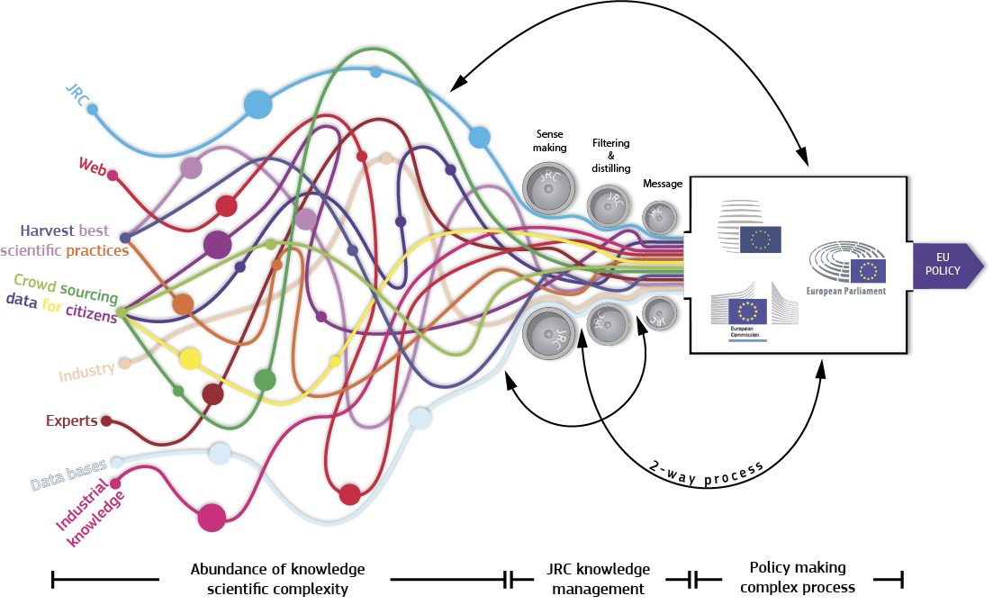
    Dealing with the information overload
Notes:
Visualisation of Knowledge Management
(animated version will also be made available)
Today we have access to a unique vast amount of information
The information comes from many sources from crowd sourcing to universities and industry to individual experts
Within the commission there is a need/wish to manage this information
The added value of the JRC is to perform this task through our expertise and the development of Knowledge Management procedures. Including sense making / filtering / visualisation of data
Further it should be noted that the process is 2-way and dynamic both in the information and policy making domains

Slide 11


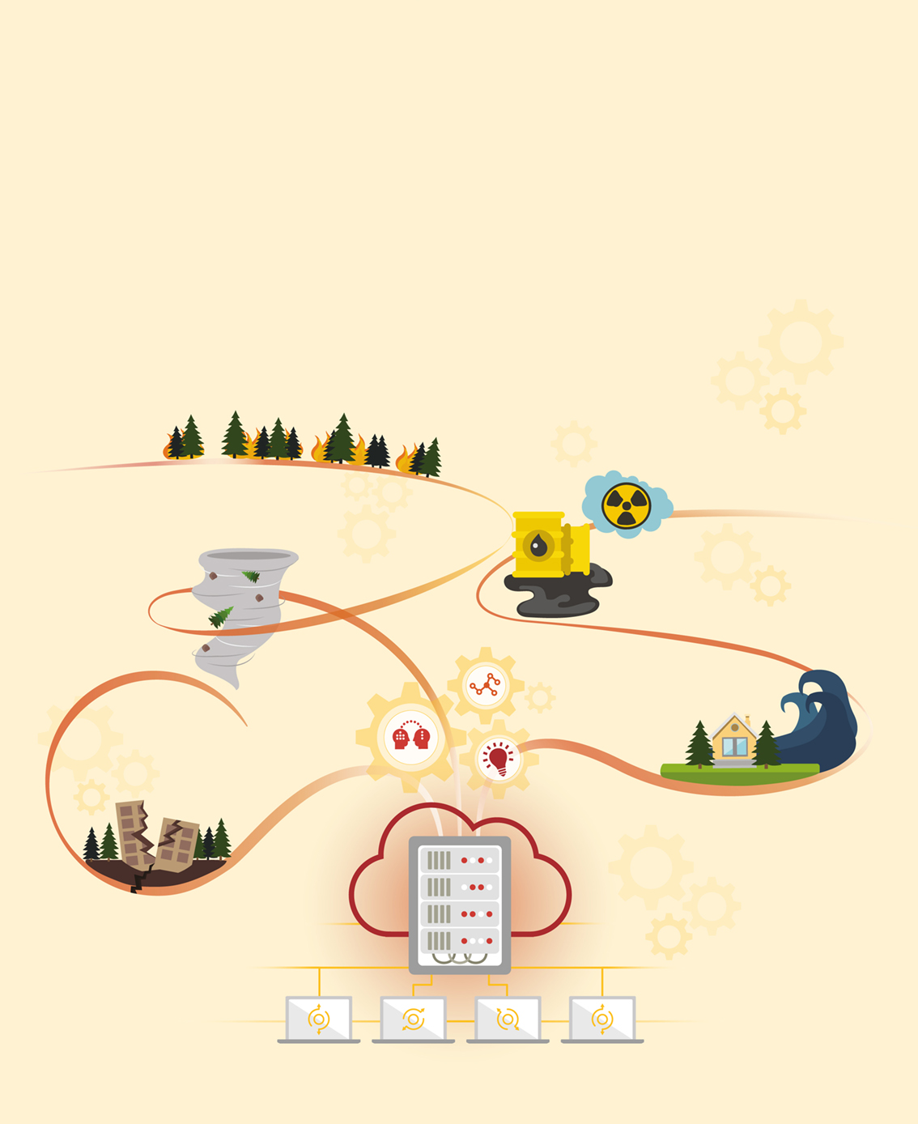
    Knowledge Centres
The European Commission’s Knowledge Centre on
Migration and Demography
The European Commission’s Knowledge Centre for
Territorial Policies
The European Commission’s Knowledge Centre for
Disaster Risk Management
Notes:
Knowledge Centres are virtual entities, bringing together experts and knowledge from different locations inside and outside the European Commission. Their objective is to inform policy-makers in a transparent, tailored and concise manner about the status and findings of the latest scientific evidence. Knowledge Centres on 'Disaster Risk Management', 'Migration and Demography' and 'Territorial Policies' were started in 2016. Two new ones will be launched in 2017 on 'Bioeconomy' and 'Information for Global Food and Nutrition Security'.

Slide 12
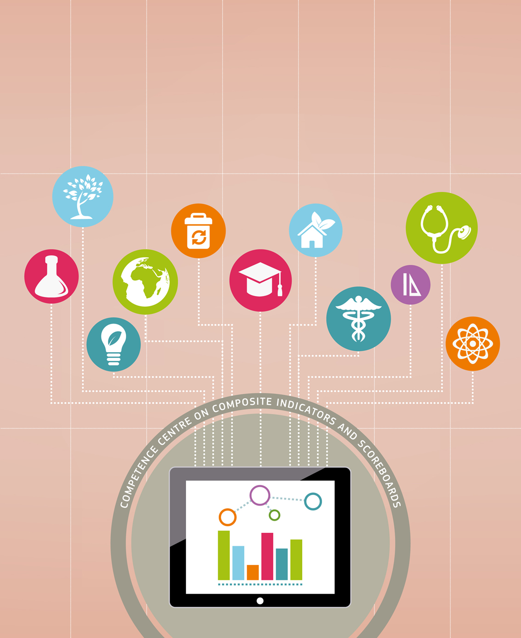


    Competence Centres
The European Commission’s Competence Centre on Composite Indicators and Scoreboards
The European Commission’s Competence Centre on
Microeconomic Evaluation
The European Commission’s Competence Centre on
Text Mining and Analysis
Notes:
Competence Centres complement Knowledge Centres by focusing on analytical tools which can be applied to any policy area, and by bringing together in one place extensive expertise in this field. The Competence Centres 'Composite Indicators' 'Microeconomic Evaluation' and 'Text Mining and Analysis' have already been established while a Competence Centre ‘Modelling', is planned for launch in 2017. The latter will include an inventory of models used by the European Commission

Slide 13
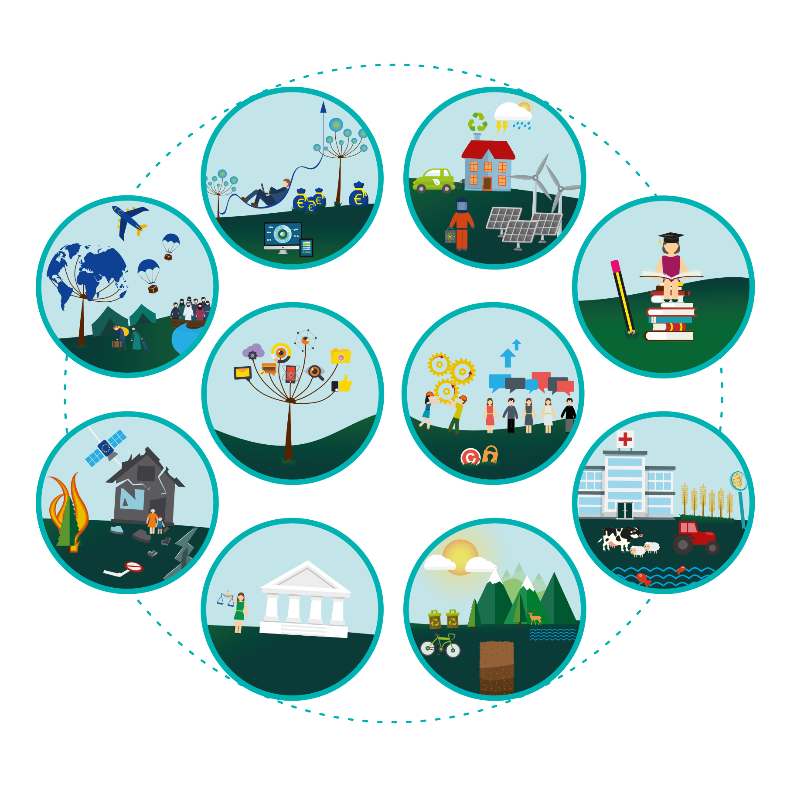
    JRC 10 Priority Nexus
          Economy, finance and markets
          Energy and transport
          Migration and territorial development
          Education, skills
          and employment
          Data and digital transformations
          Innovation systems and processes
          Civil security
          Food, nutrition
          and health
          People, governance in
          multicultural and
          networked societies
          Resource scarcity, climate change and sustainability
Notes:
As set out in the strategy, the JRC has taken a nexus-driven approach which attempts to ensure that projects are established in a multi-disciplinary manner to tackle the complex societal challenges of today. For example, the JRC is developing a Water-Energy-Food-Ecosystems project to help in a systemic way with the design and implementation of European policies that are dependent on water. By combining expertise and data from across the JRC, it will provide support to multiple partner DGs (e.g. ENER, AGRI, ENV, DEVCO, NEAR, RTD, GROW, ESTAT, EEAS), informing cross-sectoral policy making to improve

Slide 14
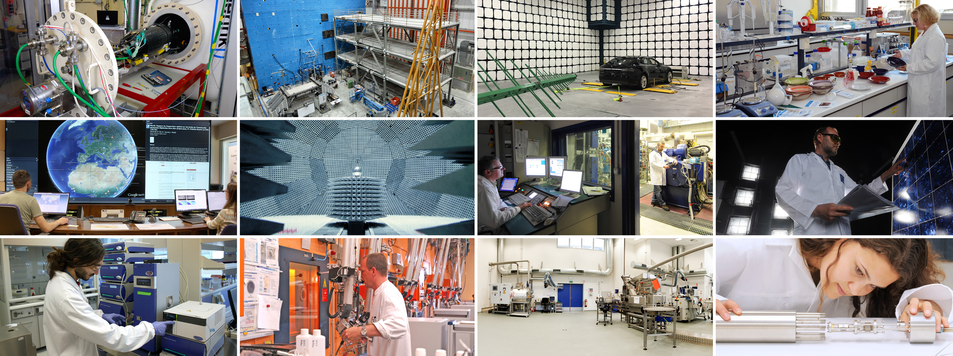
    JRC facilities
  1. Hydrogen Testing Facility, 2. European Laboratory for Structural Assessment (ELSA), 3. European Interoperability Centre for Electric Vehicles and Smart Grids, 4. Food Contact Materials (EURL FCM), 5. European Crisis Management Laboratory (ECML), 6. European Microwave Signature Laboratory (EMSL), 7. Vehicle Emission Laboratory (VELA),
  8. European Solar Test Installation (ESTI), 9. Nanobiotechnology Laboratory, 10. Hot Cell Laboratory, 11. Reference materials processing facility, 12. AMALIA Laboratory
Notes:
A selection of JRC world class facilities
Further background info
As regards scientific and IT infrastructure, long-term development plans for all JRC sites are in preparation that will address the period until 2030. In response to the recommendations of the last ex-post evaluation and as a follow-up to its strategy, the JRC made an inventory of its 68 laboratories in 2016 with the aim of identifying potential duplications, synergies, efficiencies and the potential for opening them up to external users for e.g. training purposes. This will now be taken further in order to prepare for the next FP.
An open access initiative for some of the JRC's world class research facilities aims to enhance their relevance to EU Member States. External access to JRC's research infrastructure is being piloted for some nuclear facilities, nano-biotechnology laboratories and the European Laboratory for Structural Assessment.

Slide 15

    JRC Highlights: Social Pillar
Notes:
Building a fairer Europe and strengthening its social dimension is a key priority for this Commission. The European Pillar of Social Rights is accompanied by a ‘social scoreboard’ which will monitor the implementation of the Pillar by tracking trends and performances across EU countries in 12 areas and will feed into the European Semester of economic policy coordination. The scoreboard will also serve to assess progress towards a social ‘triple A’ for the EU as a whole.

Slide 16
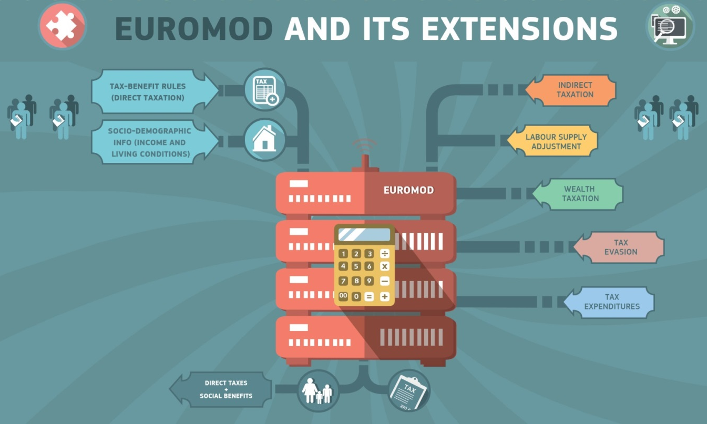
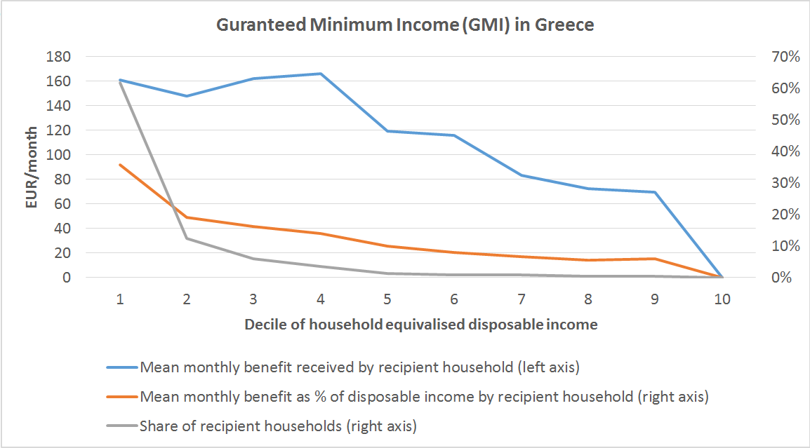
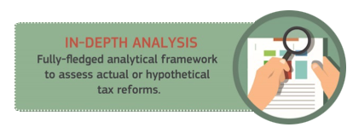
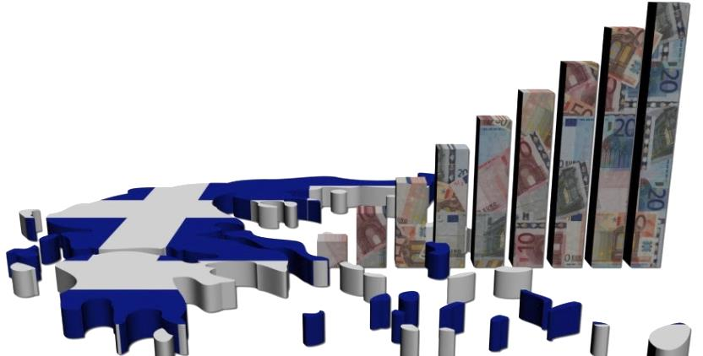
    JRC Highlights: Fiscal Policy
Notes:
JRC's fiscal modelling capacity covers personal income taxation, social security contributions and social benefits as well as corporate taxing. We assess and simulate tax and social benefit reforms in the context of the European Semester and contribute to initiatives such as the common consolidated corporate tax base (CCCTB) proposal.

Slide 17
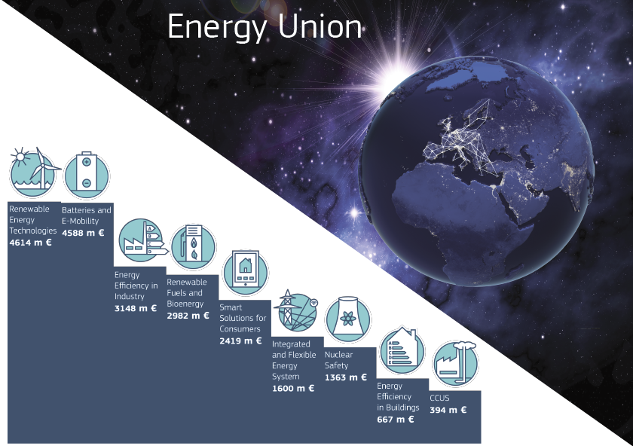
    JRC Highlights: Energy Union
JRC coordinates The SET Plan Information System, SETIS:
SET Plan strategic planning
and priority setting
  Implementation progress
  Global technology and market developments
  Dissemination portal:
    https://setis.ec.europa.eu
Notes:
Secure, affordable and climate-friendly energy is a key priority of the European Commission, through the Energy Union.
SET Plan (Strategic Energy Technology Plan):
Strategic instrument to implement the R&I and competitiveness dimension of the Energy Union, Speed up energy transition :
The JRC coordinates the The SET Plan Information System, SETIS:
SET Plan strategic planning and priority setting
SET Plan monitoring and reporting framework
Implementation progress
Global technology and market developments
Dissemination portal: https://setis.ec.europa.eu
R&I progress in the EU's energy sector – inputs to the State of the Energy Union annual reports
The JRC carries out research in the areas of energy efficiency, low-carbon economy and sustainable transport and fuels in support of Commission's transition to a secure, competitive and low-carbon economy.

Slide 18
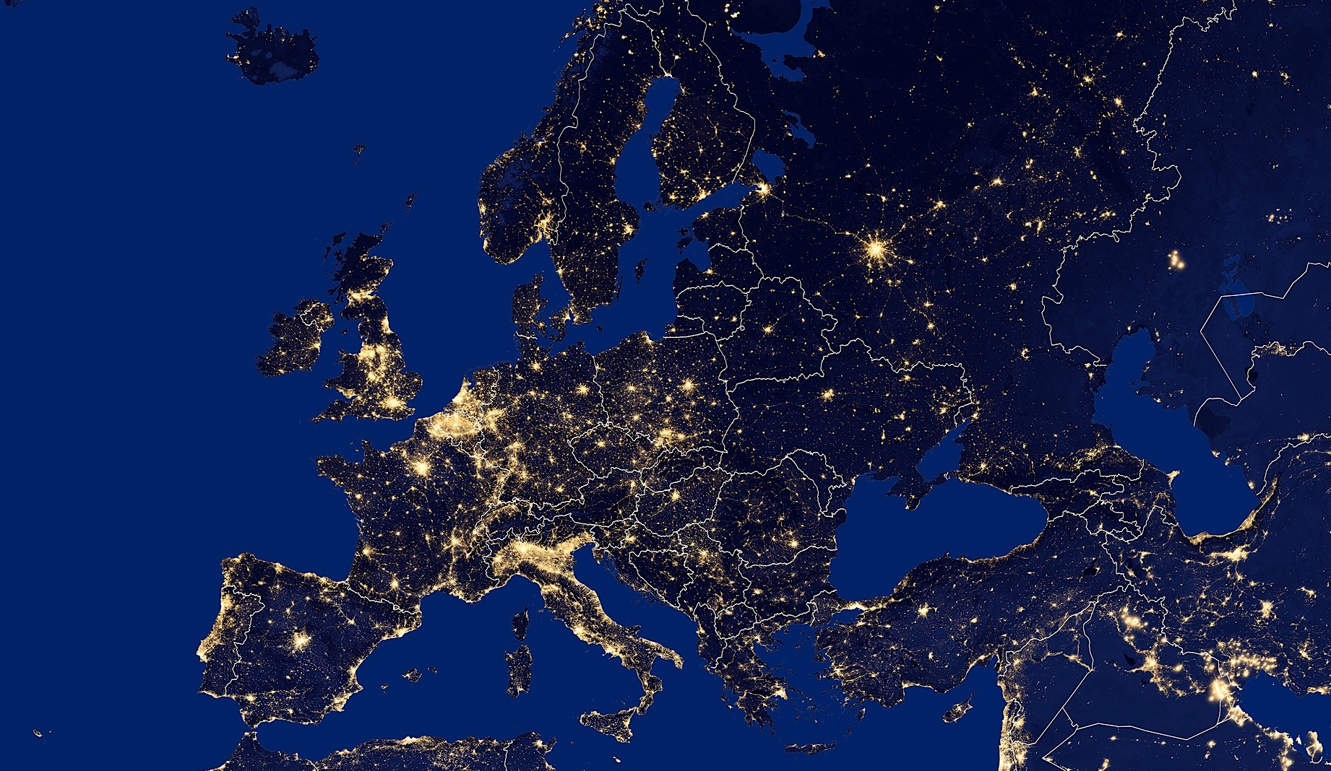
    JRC Highlights
    Keeping Europe’s lights on
    Connecting the Baltic electricity system
  © Guillaume Le Bloas - Fotolia
Notes:
Synchronisation of the Baltic States’ power system with the EU
> The JRC has been analysing the impact of the various potential scenarios agreed by the Baltic Energy Market Interconnection Plan (BEMIP) for de-synchronising the Baltic grid from the Integrated Power System of Russia and Belarus. The aim is to remove the energy isolation of the Baltic States from the rest of the EU and connect their power systems with systems using the same technical standards and developing in the same European legal framework as well as strengthen energy security in the region.

Slide 19
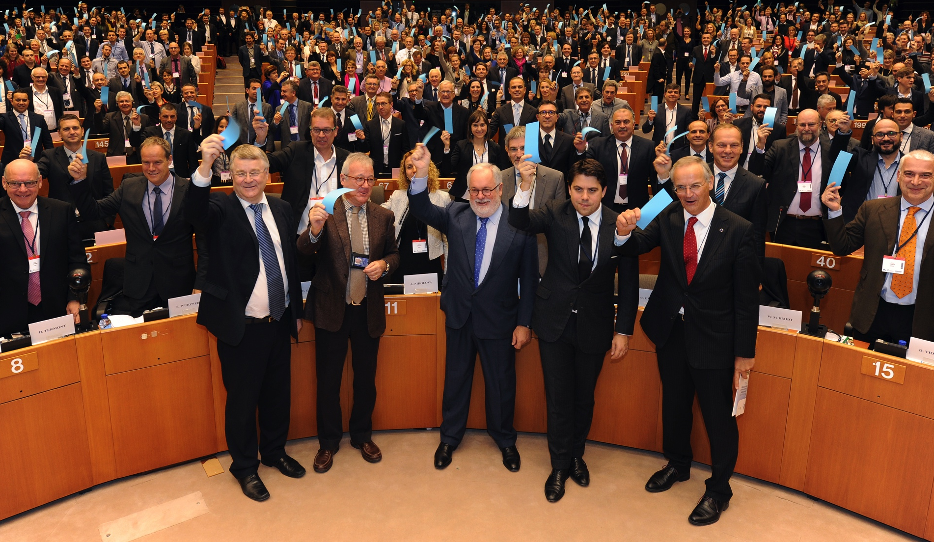
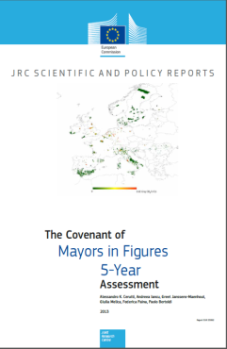
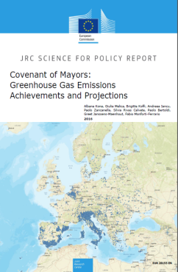
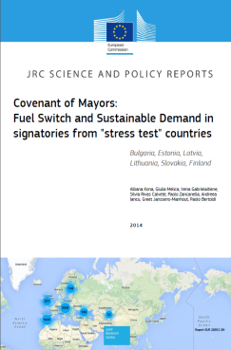

    JRC Highlights: Covenant of Mayors
Notes:
The Covenant of Mayors is an ambitious initiative of the European Commission that gives the lead to Europe’s pioneering cities to mitigate climate change through the implementation of intelligent local sustainable energy policies that create stable local jobs, increase citizens’ quality of life and address crucial social issues.
The JRC has provided scientific and technical support to this initiative since its launch, based on its expertise in both fields, sustainable energy and climate mitigation. It has, for instance, developed the methodology and guidelines for setting up local greenhouse gas inventories and defining appropriate sustainable energy actions for the signatories.
The JRC has also defined the monitoring methodology for assessing the signatories' progress towards their targets and has supported them in their efforts to increase their capacity and operational performance.
The JRC is also responsible for the review and analysis of the submitted Sustainable Energy Action Plans and emission inventories of the CoM signatories.
In addition, JRC scientists operate a helpdesk service to the signatories, aimed at increasing their capacity and operational performance.

Slide 20
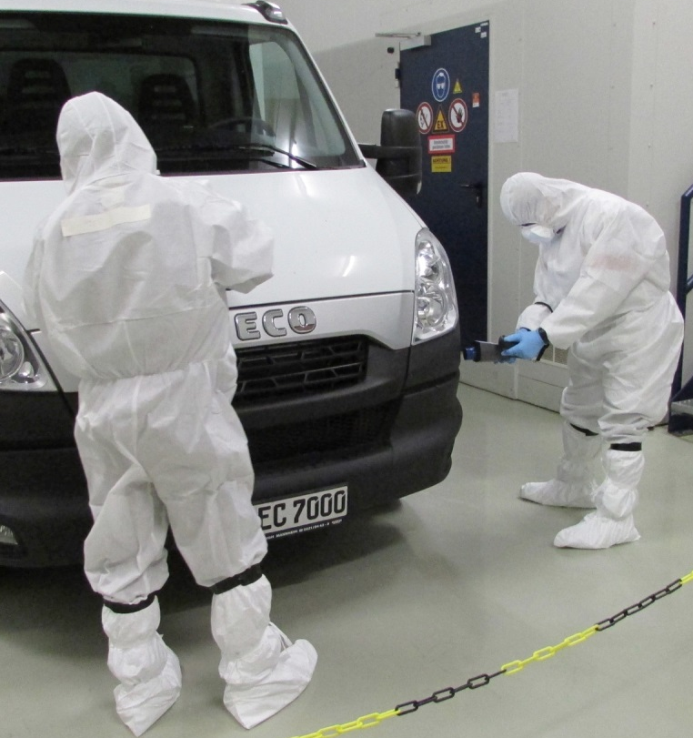
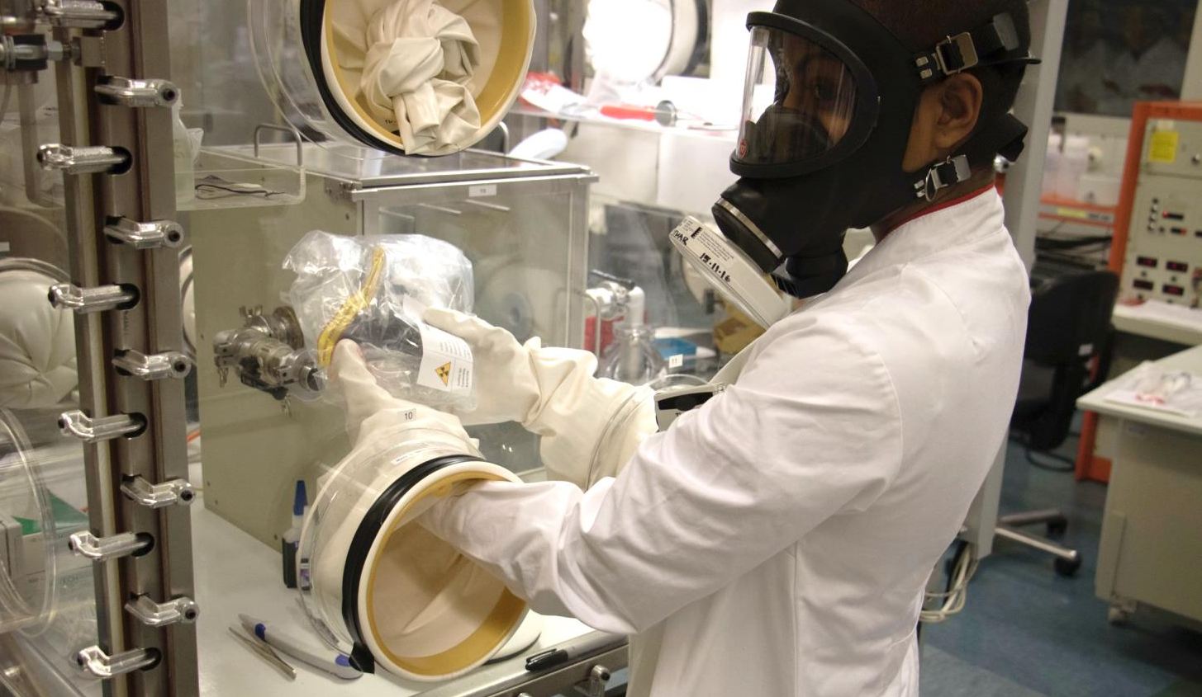
    JRC Highlights: Nuclear Detectives | EU Training Centre
Notes:
A key component of JRC's nuclear strategy is the scientific/technical support to nuclear regulators at European (Euratom, via DG ENER) and international level (IAEA). This includes technical developments and operational support to inspection activities, such as the quantitative assay of nuclear materials at fuel cycle installations, independently of the operators.
Within the EU's CBRN Action Plan, the EUSECTRA training centre (EUropean nuclear SECurity TRAining centre) was set up at JRC in order to train national security personnel and nuclear inspectors on the detection and identification of nuclear materials, at EU level and internationally. Training courses are based on the use of a wide range of uranium and plutonium samples for realistic training scenarios.
The JRC has also developed methods for investigation of seized materials and developed response plans for incidents involving nuclear material. JRC has a team on standby at all times to respond immediately to a seizure of nuclear materials. Scientists working in sophisticated laboratories contribute to the development of specific expertise in the analysis of seized nuclear material by forensic methods.

Slide 21
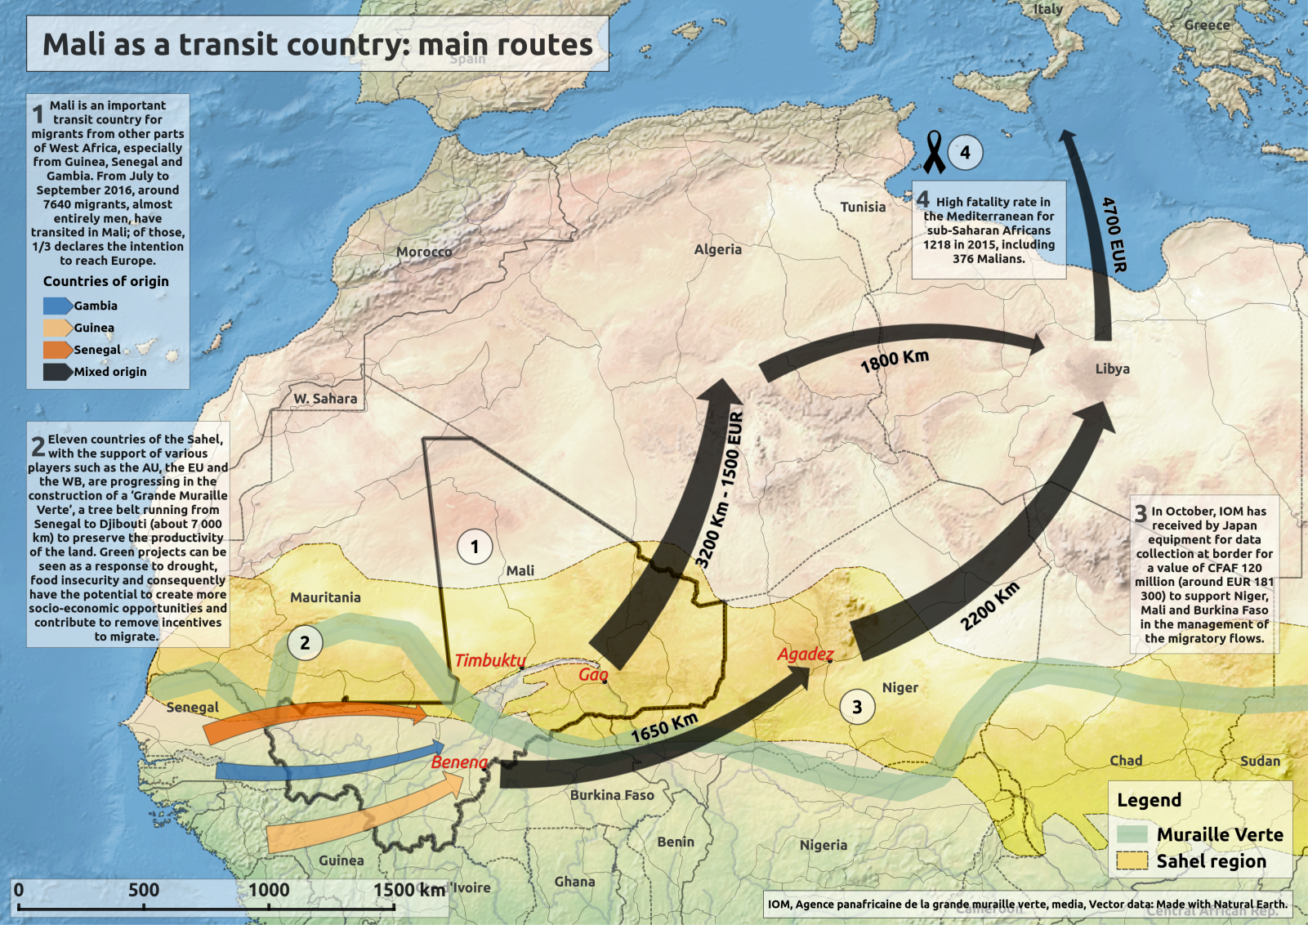

    JRC Highlights: Migration
  Photo © Ettore Ferrari
Notes:
A new policy on migration. Through the Knowledge Centre for Migration and Demography, the JRC is building a stronger evidence base for policy making
The European Commission's agenda on migration sets out a European response combining internal and external policies, making the best use of EU agencies and tools and involving all actors; EU countries and institutions, international organisations, civil society as well as partners outside the EU. The JRC supports the Commission in its work in this area through its research on crisis management, surveillance, transport safety and security and antifraud.

Slide 22
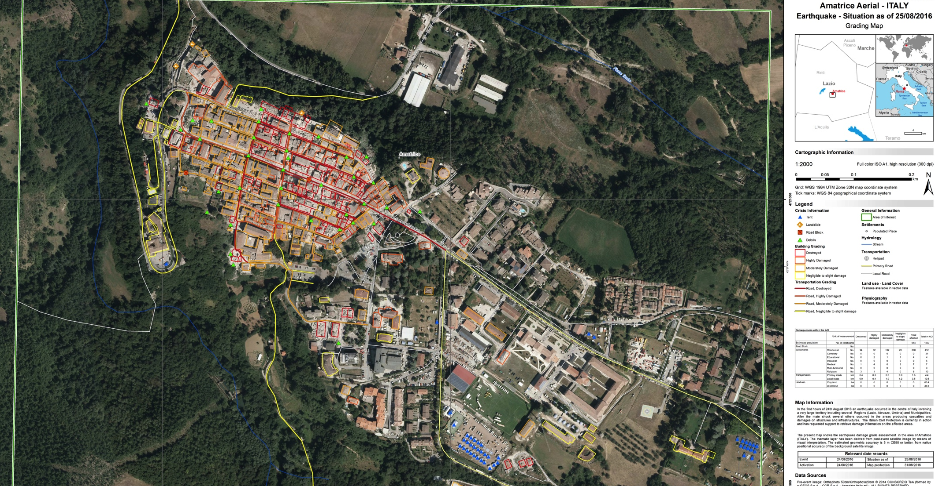
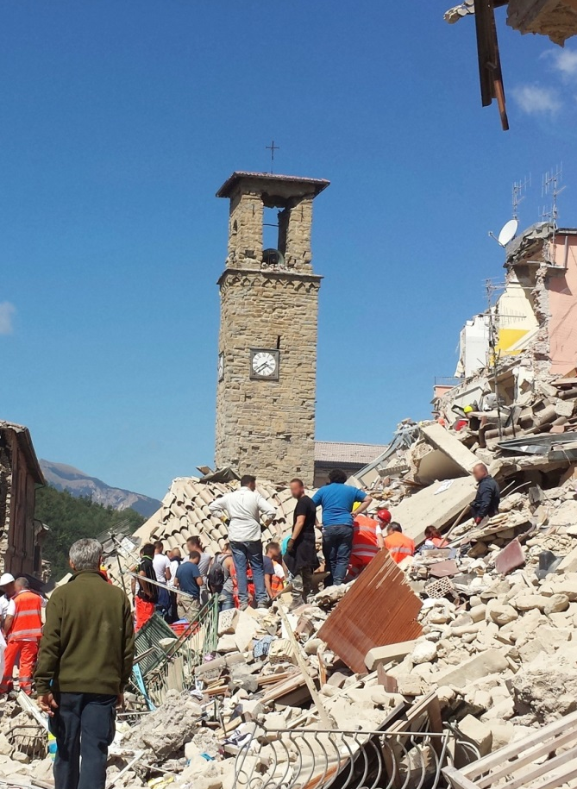

    JRC Highlights: Amatrice (IT) Earthquake
  Photo of Amatrice on 24 August 2016 after the earthquake, © Antonio Nardelli - Fotolia
Notes:
Building on its strong record of international cooperation, the EU needs a strong common foreign policy to anticipate events early and identify common responses. In bringing together more effectively its different policies and tools that contribute to Europe's external action, the European Commission can respond to global challenges and project its values worldwide. The JRC carries out research in support of such policies in the areas of global safety and security, crisis management, disaster risk reduction and monitoring natural and man-made hazards.

Slide 23
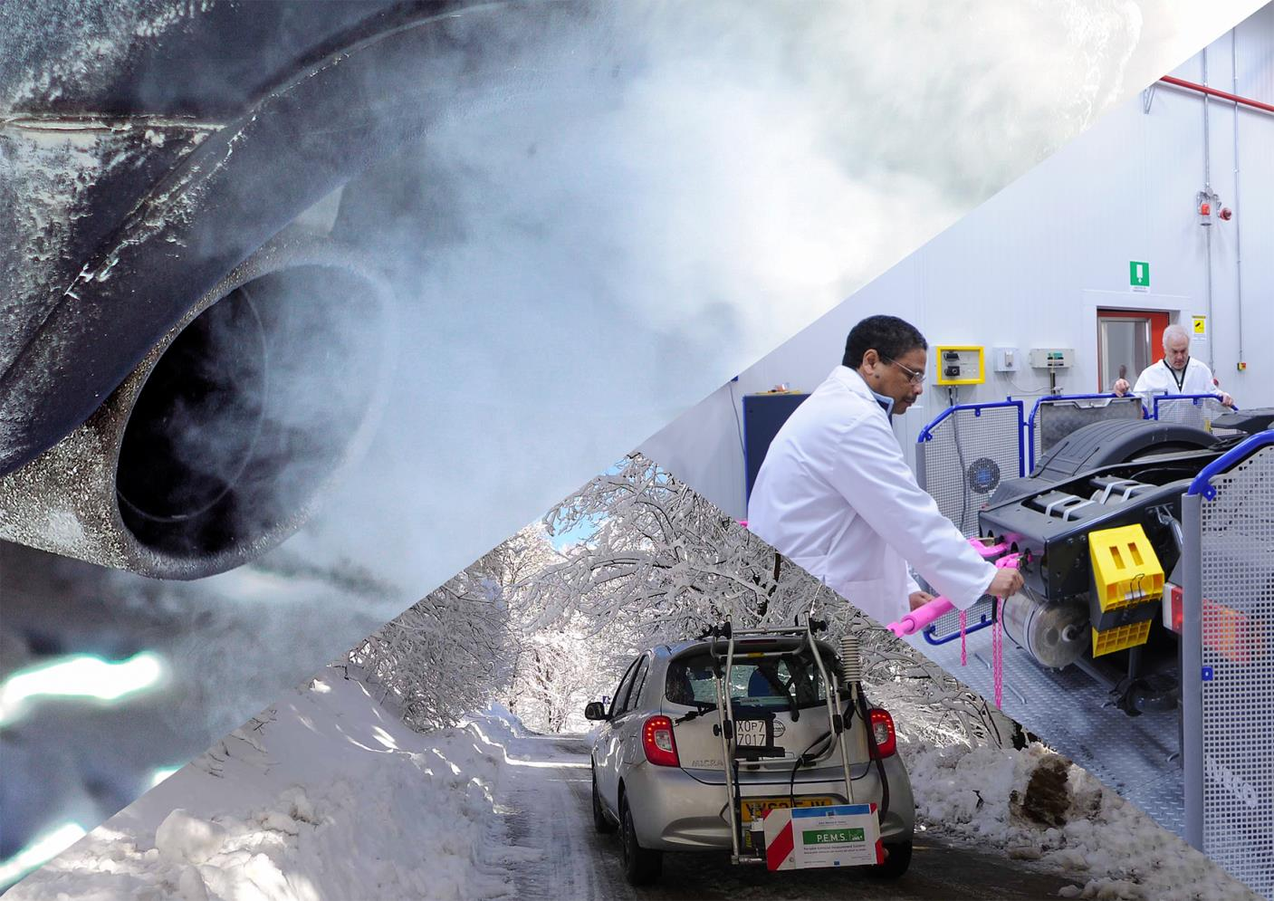
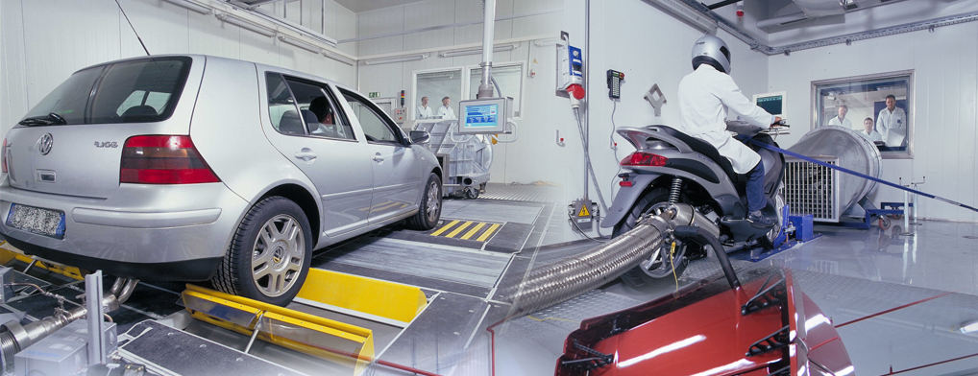
    JRC Highlights: Energy Union | Vehicle Emissions
Notes:
Secure, affordable and climate-friendly energy is a key priority of the European Commission, as its role during the Paris climate conference (COP21) clearly demonstrated. The JRC carries out research in the areas of energy efficiency, low-carbon economy and sustainable transport and fuels in support of Commission's transition to a secure, competitive and low-carbon economy.
The vehicle emissions laboratories shown here comprise several testing facilities equipped to measure environmental performance, energy efficiencyamd clectromagnetic emissions from a large range of vehicles.
The quantitative analysis of motor vehicle emissions is increasingly important for the development of effective European legislation.

Slide 24

    JRC Highlights: GMO | Dioxins | Mad cow disease | Nanotech
  Photo of cows © countrypixel – Fotolia; photo of cobs © atoss - Fotolia
Notes:
Standards stimulate and enable innovation and competiveness in Europe, and are a key objective of the EU-US Free Trade Agreement. Industry needs framework conditions which are the basis on which to invest, innovate and gain global market share in an increasingly competitive world. Standardisation brings efficiency and trust to industry and consumers. Across the JRC, three quarters of our work contributes to supporting the standardisation system in areas spanning from environmental monitoring to critical infrastructure protection and from food safety to nuclear safety and security.

Slide 25
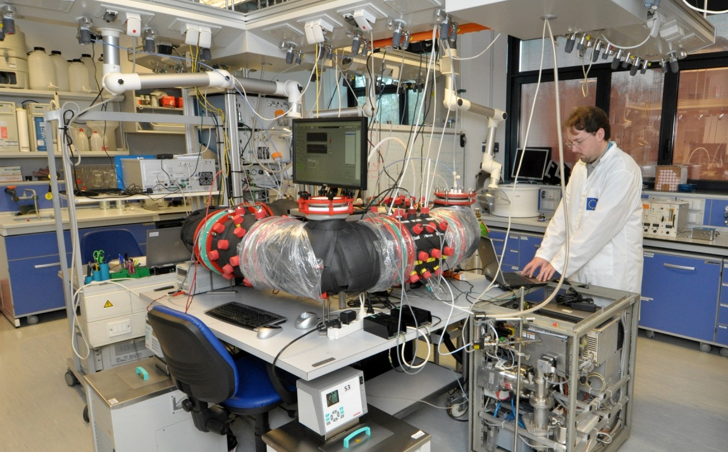
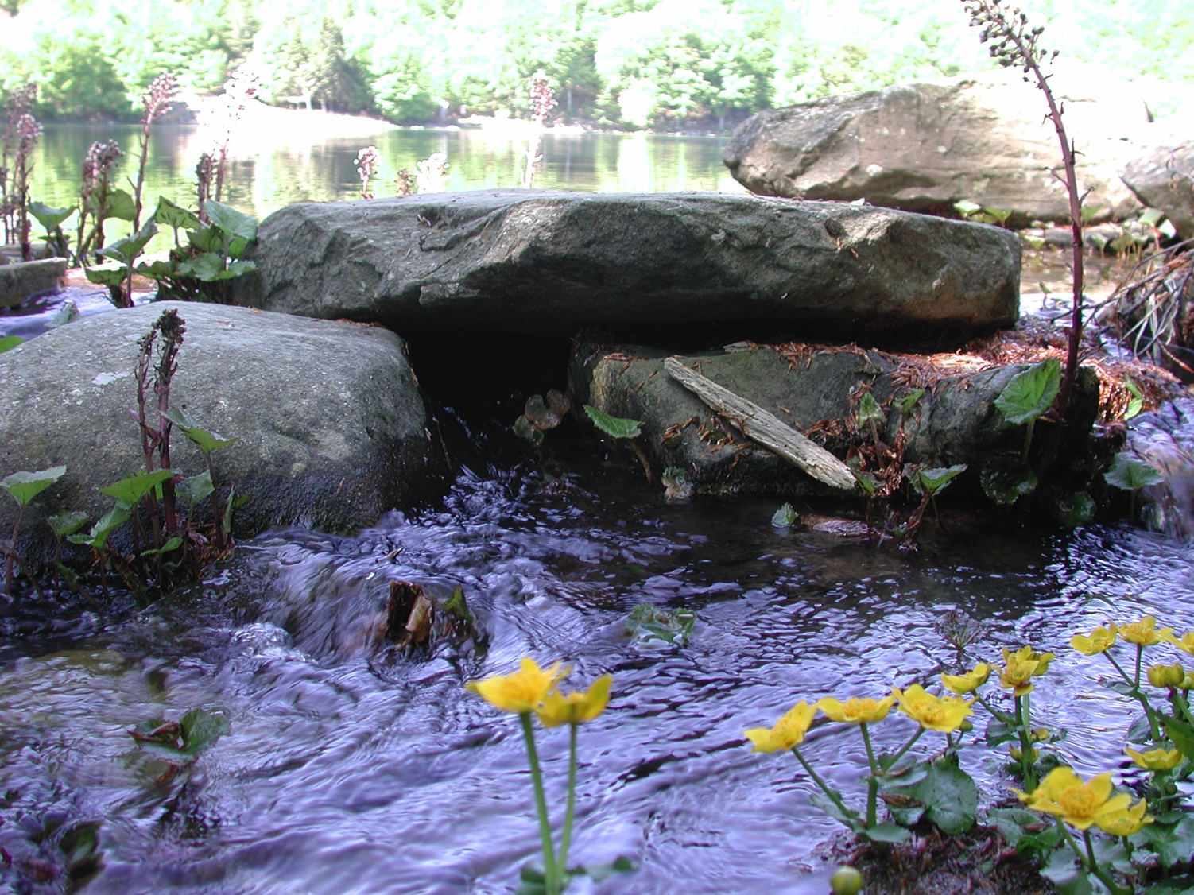
    JRC Highlights: Air & water quality monitoring
Notes:
To support the modernisation of EU air pollution and climate change legislations, the JRC is working to harmonise air and climate monitoring and modelling methodologies, to develop coherent greenhouse gas (GHG) and air pollutant emission inventories and projections, and to carry out econometric trend analyses and cost estimates of emission control options. In addition, the JRC performs much of its work in the context of international programmes that operate at the interface of science and policy, e.g the UN Convention on Long-range Transboundary Air Pollution (CLRTAP), and the Intergovernmetal Panel on Climate Change (IPCC).
The JRC supports several pieces of legislation including the Water Framework Directive (WFD) and its associated daughter Directives. In the context of the WFD, the JRC is actively involved in the Blueprint to safeguard Europe's water resources (the "Blueprint”) initiative. This initiative, which is part of the EU 2020 Strategy and the Resource Efficiency Roadmap, aims to ensure that good quality water is available in sufficient quantities for all legitimate uses.
The JRC provides scientific assessments to address societal and economic challenges deriving from the evolving vulnerability of the European and global water environment. In particular, it develops modelling tools to predict climate change impacts on water, assesses water governance in developing countries and carries out studies on the preservation of ecosystems.

Slide 26
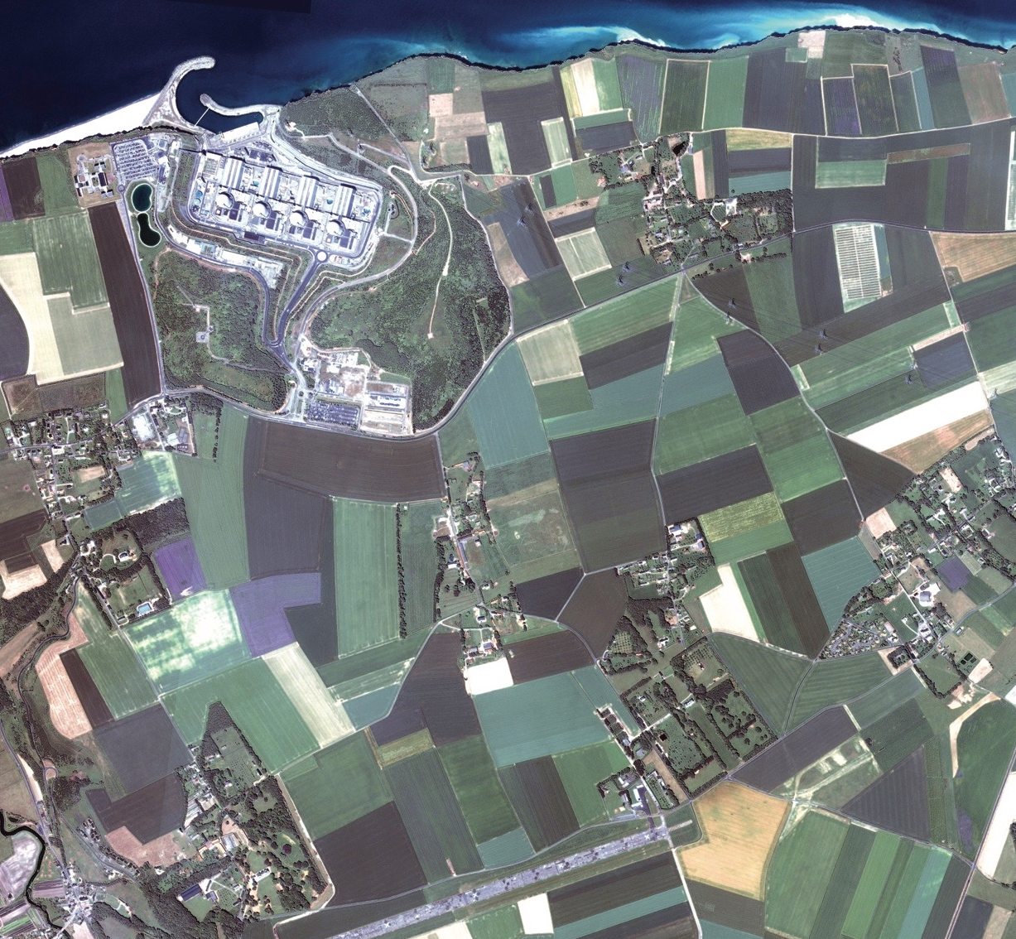
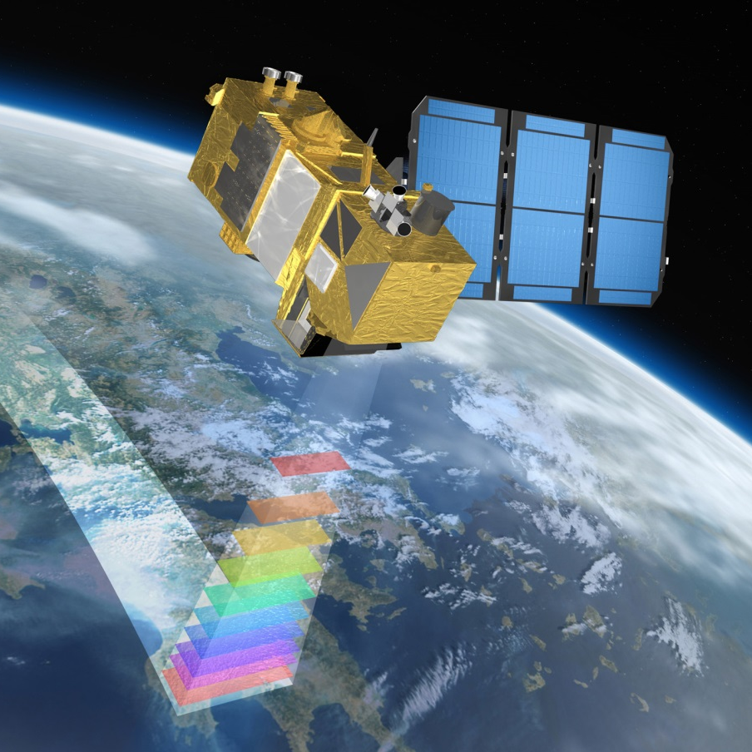

    JRC Highlights: Common Agricultural Policy (CAP)
  Sentinel-2 © Astrium GmbH
Notes:
Agricultural monitoring is carried out at the JRC mainly to distinguish, identify and measure the main crop production areas in Europe, estimate production early in the year and check the validity of farmers’ applications for EU subsidies. The European Commission uses satellite earth-observation data as a cost-efficient way of gathering the necessary monitoring information.

Slide 27
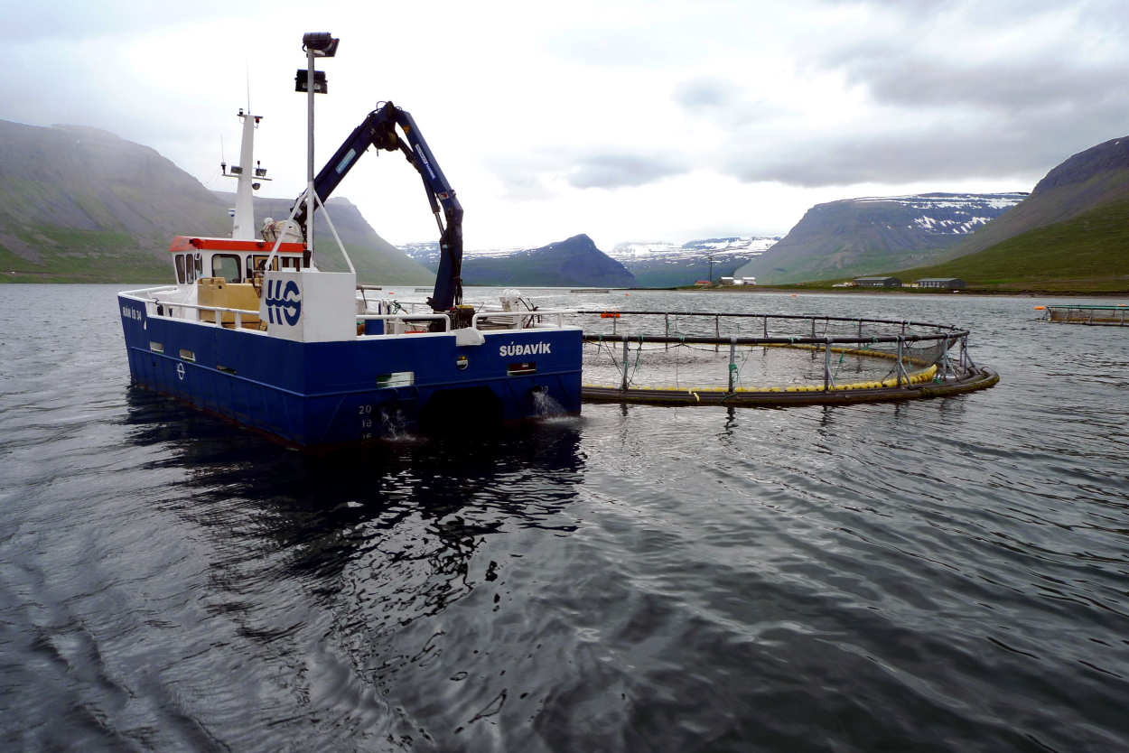
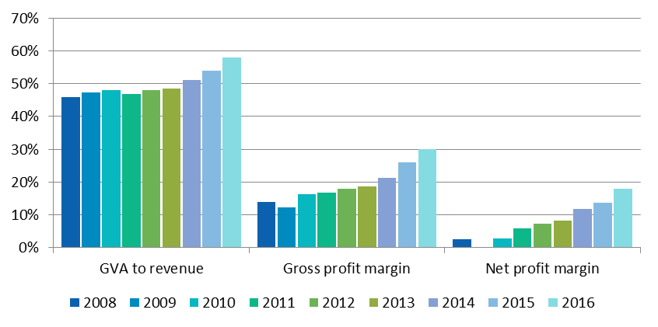
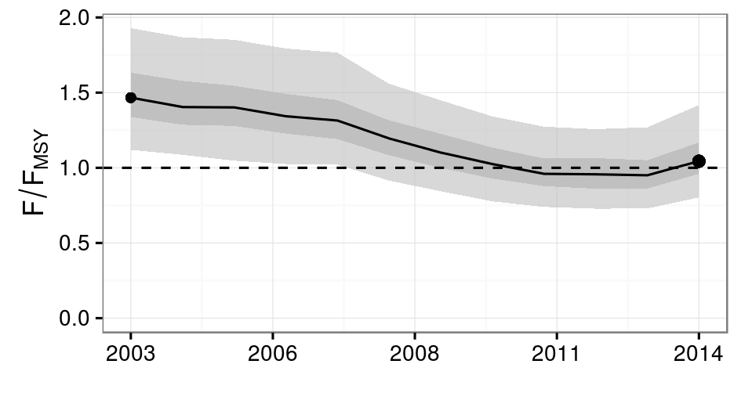
    JRC Highlights: Common Fisheries Policy (CFP)
Economic Performance of the EU Fishing Fleet
Performance of the Common Fisheries Policy
  Photo © European Union, Photographer: Fuensanta Salas Herrero
Notes:
Scientific knowledge and data are indispensable to the Common Fisheries Policy (CFP), because policy decisions have to be built on robust and sound knowledge about the level of exploitation that fish stocks can sustain as well as effects of fishing on marine ecosystems. From stock assessment and Management Strategy Evaluation (MSE) to fish habitat and genetics for fish traceability to aquaculture and economic analysis of the fisheries sector, JRC's research in this field contributes to sustainable fisheries management, supporting the European Commission scientifically in the implementation of the CFP.

Slide 28
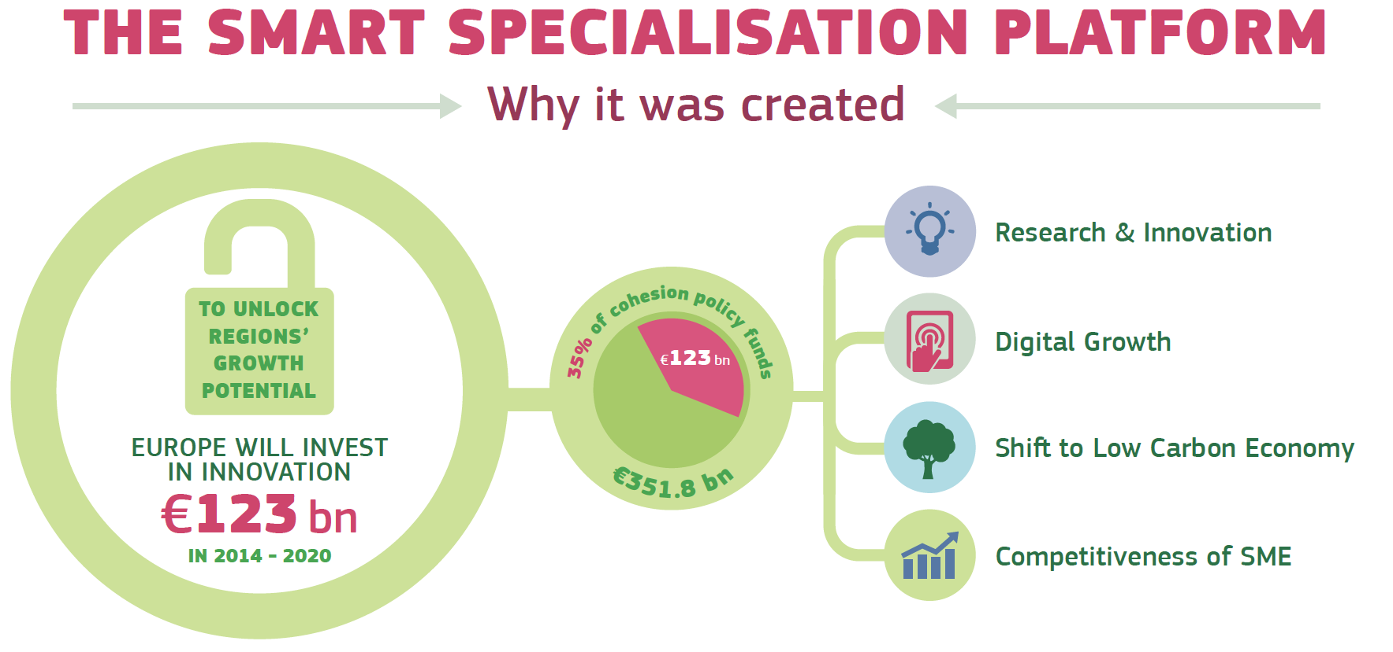
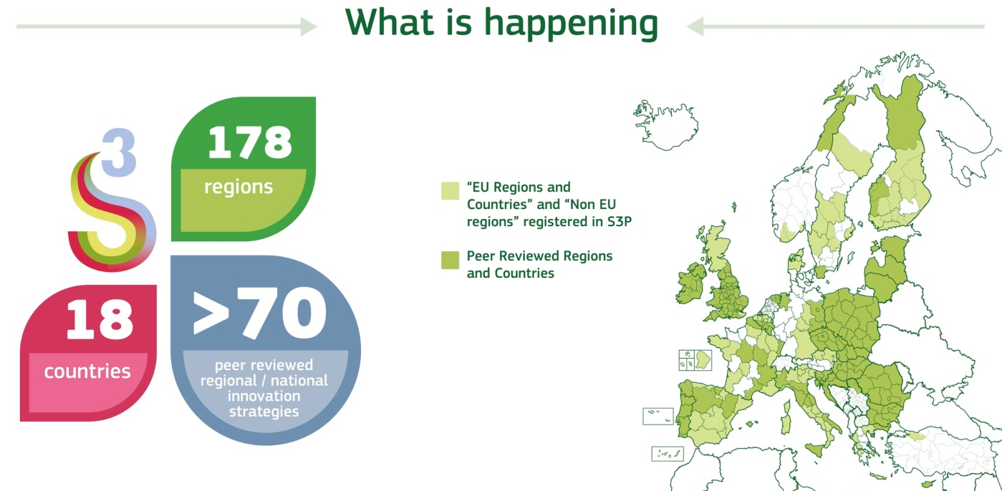
    JRC Highlights: Regional Policy
Notes:
The JRC supports the design and implementation of territorial development policies and assesses their impacts. Our research is at the crossroads of EU regional, cohesion, research, innovation and industrial policies, and covers investment and innovation-driven territorial development, smart specialisation and territorial innovation ecosystems.
Support to regional policy and territorial growth. The JRC has set up a Knowledge Centre for Territorial Policies to provide demographic and economic projections and alternative scenarios for policies and investments. It also operates the Smart Specialisation Platform which provides professional advice to regions on research and innovation strategies

Slide 29
    Working at the JRC
English as Main Working Language
International Teams with diverse backgrounds
Results for policy-makers
Delegations to policy teams in Commission (e.g. COP)
Tight deadlines and long-term projects
Bringing in national perspectives
European Schools

Slide 30

    How to join: Permanent Officials
Website: https://ec.europa.eu/jrc/en/working-with-us/jobs/permanent-positions
Administrators (AD): drafting
policies, managing scientific
research programme, etc.
Assistants (AST): executive and
technical role in e.g. administrative,
financial, research implementation
Assistants/Secretary Clerk (AST/SC)
Selection organised through open competitions by the European Personnel Selection Office (EPSO) http://europa.eu/epso/index_en.htm

Slide 31
    How to join: Temporary Posts
Contract staff members
Grantholders
Marie Skłodowska-Curie
Grantholders
Temporary Agents
Seconded National Experts
Trainees
Unpaid Visiting Scientists
Invited Persons
Website: https://ec.europa.eu/jrc/en/working-with-us/jobs/temporary-positions
Notes:
The JRC's nuclear work is funded by the EURATOM Research and Training Programme
Objective to pursuit research, knowledge management and training activities with an emphasis on nuclear safety and security

Slide 32

    How to join: Contract Staff Members
Four Function Groups:
  FG I: Manual and administrative
  support tasks
  FG II: Clerical secretarial tasks
  FG III: Executive tasks
  FG IV: Administrative, advisory or other scientific/technical tasks
For FGII-IV contracts up to the maximum of 6 years
For FG I an indeterminate contract can be offered
Selection through open calls organized by EPSO or through dedicated calls for expression of interest (e.g. http://ec.europa.eu/civil_service/job/index_en.htm)
A new call for researchers in FG IV is regularly launched by the JRC:
https://ec.europa.eu/jrc/en/working-with-us/jobs/vacancies/function-group-IV-researchers

Slide 33
    How to join: Trainings
The JRC offers a number of regular courses that take place at its laboratories and facilities across the EU
For more information on specific education opportunities, including all the necessary details and contact information, please see our dedicated page on training programmes:
https://ec.europa.eu/jrc/en/training-programmes
List of upcoming training events:
https://ec.europa.eu/jrc/en/training-events-list

Slide 34
    How to join: Grantholders
Ph.D. students and experienced scientists (i.e. at least 10 years of experience at post-doc level)
Pilot on Collaborative Doctoral Partnerships
Can be of any nationality (a derogation from the DG must be granted for recruitment of Third Country Nationals)
Contracts under the national employment law of the site where the JRC Institute is based:
  For Ph.D. students contracts from 12 to 36 months
  For experienced scientists contracts from 3 to 24 months
  Grantholders are recruited through open calls published on the JRC’s External Staff Recruitment Application (ESRA) http://recruitment.jrc.ec.europa.eu

Slide 35
How to join: Marie Skłodowska-Curie Grantholders
Individual Fellowships
Ph.D. students or researchers with at least 4 years of research experience
Compliance with the mobility rule
Contracts under the national employment law of the site where the JRC Institute is based for a duration of 12-24 months
  Opportunities available on the MSCA portal
  http://ec.europa.eu/research/mariecurieactions/index_en.htm
  Guide for applicants: http://ec.europa.eu/research/participants/portal/doc/call/h2020/h2020-msca-if-2014/1600147-guide_for_applicants_if_2014_en.pdf

Slide 36

    How to join: Temporary Agents
Specialists dealing with scientific/technical
tasks selected through open competitions organized by EPSO (http://europa.eu/epso/index_en.htm)
Typically, the contract is awarded for an
initial period of 4 years and may be renewed
not more than once for a period of 2 years

Slide 37
    How to join: Seconded National Experts (SNE)
Staff employed by a national, regional or local public administration or an IGO who are working temporarily for the European Commission
SNEs remain in the service of their national employer throughout the period of secondment
The SNE’s employer shall continue to pay their salary and maintain their administrative status throughout the period of secondment
Typically, the secondment may not be less than 6 months or more than 2 years. It may be renewed up to a maximum total of 4 years.

Slide 38

    How to join: Trainees
Enable students or recent graduates
to practise what they have acquired
during their studies
Two types of traineeships at JRC:
  training related to the preparation of a degree thesis
  training after university education
Trainees are selected through open calls published on the JRC’s External Staff Recruitment Application (ESRA)
http://recruitment.jrc.ec.europa.eu
Duration ranges from 3 to 5 months

Slide 39

    How to join: Unpaid Visiting Scientists
JRC can host scientists from a scientific public body, university, organisation, institute or private company conducting research
An agreement is signed between the sending organisation, the UVS and the JRC
The agreement does not create in any way an employment relationship between the JRC and the UVS
No transfer of money between the parties in connection with the agreement
Duration ranging from 1 to 12 months

Slide 40


    How to join: Invited Persons
Collaboration Agreements provide a legal framework for cooperation between the JRC and other organisations, in particular research institutes, and allow also for the possibility of exchange personnel
Similarly as for UVS invitation of a person to the JRC must be in the framework of scientific and technological collaboration without exchange of funds
The duration of an invitation cannot normally exceed 12 months. Extensions are possible.

Slide 41





    Stay in touch!
ec.europa.eu/jrc
@EU_ScienceHub
EU Science Hub - Joint Research Centre
Joint Research Centre
EU Science Hub

Slide 42

Thanks
Questions?
You can find me at martin.muehleck@ec.europa.eu

